Slide 1
UNIVERSITY OF VIENNA · BUSINESS INTELLIGENCE 1 · SUMMER 2026
Are FIFA Rankings
Actually Predictive?
Assignment 1
GROUP 1
Faik Koprenca
Irdi Kuka
Oladimeji Rahiim Aremu
Redi Ceni
Joana Jaupi
12449192
12407107
12446645
12449250
12448983
May 15, 2026
Notes:
Open with: 'We're asking whether FIFA rankings are actually predictive. We checked using 26,500 international matches from 1993 to 2024.' Don't pause, move on.

Slide 2
WHY THIS MATTERS
Rankings decide things, but nobody checks them
Rankings drive tournament seeding, World Cup qualification slots, and billions in betting markets. But they're rarely tested against what actually happens.
Federations
Bookmakers
Researchers
Use rankings for seeding and qualification slots.
Price odds based on the ranking signal.
Baseline for sports analytics work.
BI Assignment 1 · University of Vienna
2 / 14
Notes:
30 seconds: rankings touch a lot of decisions, but nobody really audits them. That's the gap we step into.

Slide 3
TASK 1 · TOPIC & DATA
Two public datasets joined on country and date
International Football Results
OUR FACT
One match between two national teams on a specific date in a specific tournament, with both teams' FIFA ranking at the time.
Kaggle · martj42
49,287 matches
date, home_team, away_team, scores, tournament
HOW THEY CONNECT
FIFA World Ranking
Join on country and date. Each match gets the most recent ranking that was available before kickoff.
Kaggle · cashncarry
67,472 monthly snapshots
rank, country, total_points, confederation, rank_date
BI Assignment 1 · University of Vienna
3 / 14
Notes:
Two Kaggle datasets — match results back to 1872, FIFA rankings back to 1992. Each row in our fact table is one match between two teams with their rankings attached at the time.

Slide 4
TASK 2 · ANALYTICAL FOCUS
Four questions, four dimension combos
Tournament Type × Date
Year × Match Context
How well do rankings predict outcomes across tournament types?
Has home advantage changed over time?
01
02
This tells analysts, fans, federations, or media whether FIFA rankings are reliable predictors, and whether pressure/tournament intensity makes outcomes less predictable.
Tests if 'globalization killed home advantage' is real.
Confederation × Confederation
Rank Gap × Top-20 Tier
Which confederations beat or underperform their ranking?
When are rankings reliable, and when do they fail?
03
04
Reveals where the ranking model has blind spots; whether teams from some confederations are underrated or overrated internationally, which is useful for scouting, tournament forecasting, and evaluating ranking fairness.
Useful for big gaps but unreliable for close matchups?
BI Assignment 1 · University of Vienna
4 / 14
Notes:
90 seconds. Four questions, each on a different dimension cut. Q1 = tournament type. Q2 = year. Q3 = confederation. Q4 = ranking gap size.

Slide 5
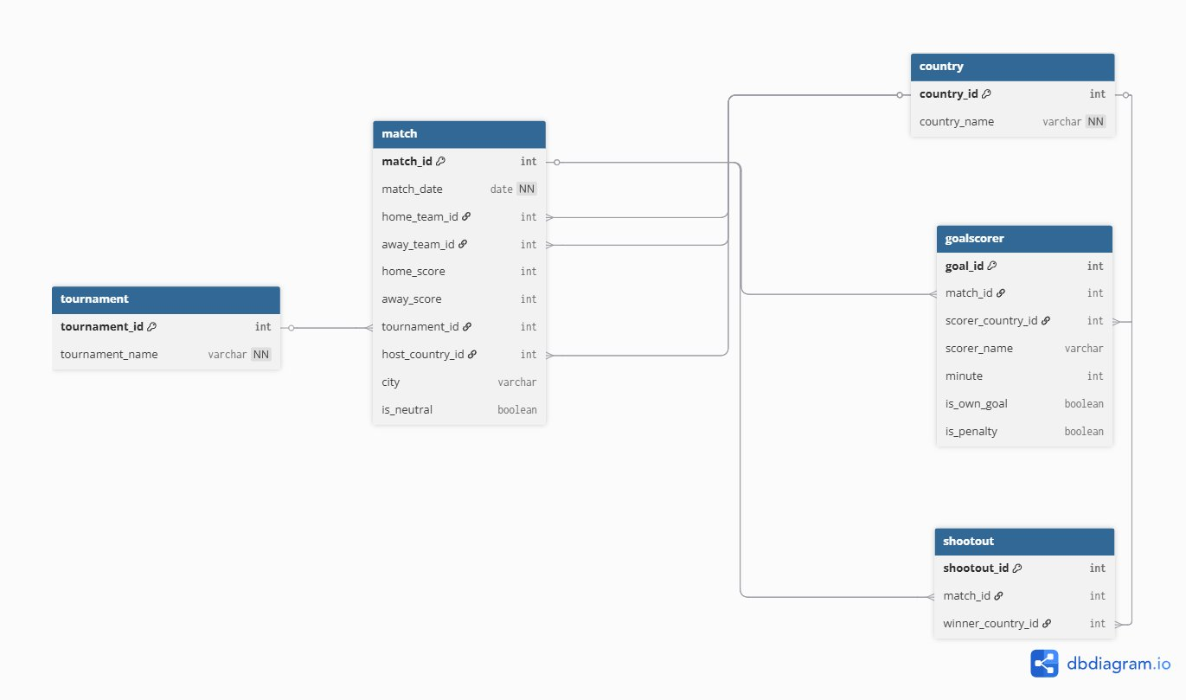
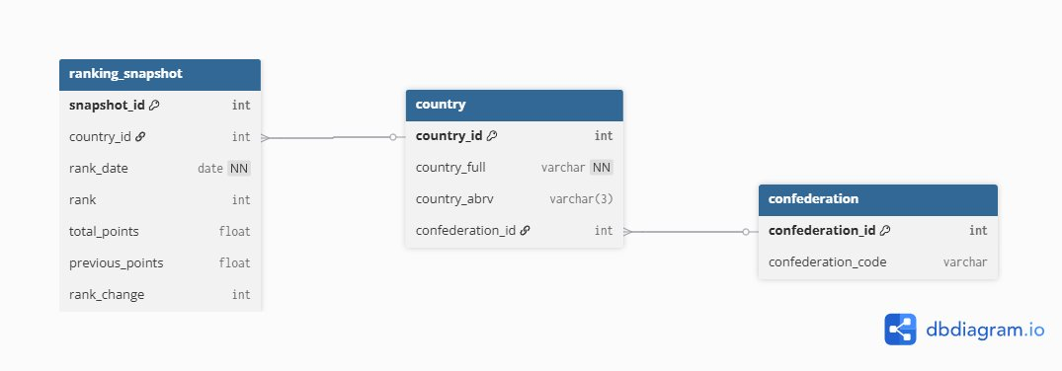
TASK 3 · DATA MODELING
Both source datasets in 3NF
Matches dataset
Rankings dataset
Country and Tournament split out as their own entities.
Confederation split out so it doesn't depend on country.
BI Assignment 1 · University of Vienna
5 / 14
Notes:
Both source datasets normalized to 3NF. Country and Tournament factored out on the left. Confederation factored out on the right to avoid a transitive dependency.

Slide 6
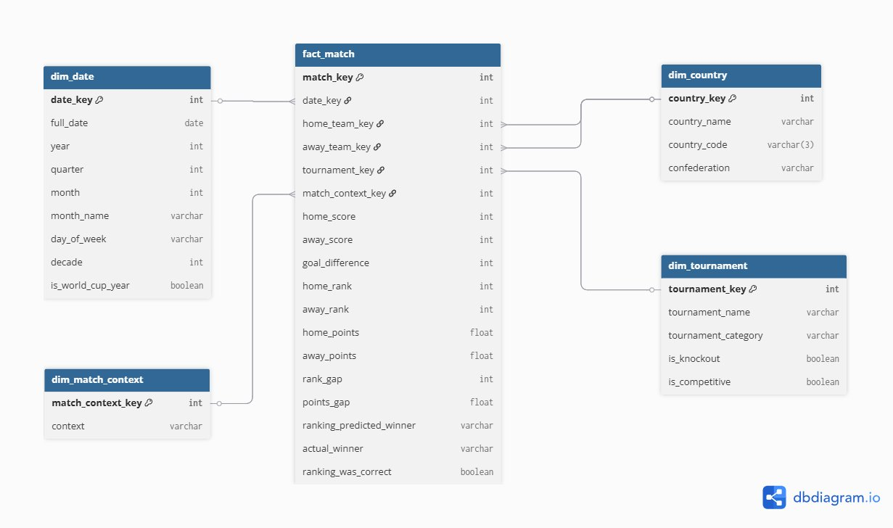
TASK 3 · STAR SCHEMA
One fact table, four dimensions
DESIGN CHOICES
Grain
One row = one match. With both rankings attached.
Role-playing country
dim_country joins twice: home and away.
Confederation denormalized
Moved into dim_country to keep queries simple.
BI Assignment 1 · University of Vienna
6 / 14
Notes:
Grain is one match. dim_country plays two roles — home and away. Confederation moved into dim_country for simpler queries. Standard OLAP move.

Slide 7
TASK 4 · PIPELINE
Python ETL, runs end-to-end with one command
EXTRACT
TRANSFORM
INTEGRATE
BUILD
LOAD
Read CSV inputs
Clean, map countries
as-of join rankings
Build dimensions
Write star schema
TWO REAL PROBLEMS WE HAD TO SOLVE
Country names didn't match
18 country names were different between the two datasets — Iran vs IR Iran, USA vs United States, Czech Republic vs Czechia. We fixed them with a mapping CSV that documents every rename.
Rankings are monthly, matches are daily
A regular join on equal dates would lose most matches. We used merge_asof to grab the most recent ranking before each match — never a future one.
BI Assignment 1 · University of Vienna
7 / 14
Notes:
Two real problems: country naming and time alignment. Country fix uses a mapping CSV with audit notes. Time fix uses merge_asof to grab most recent ranking — never future.

Slide 8
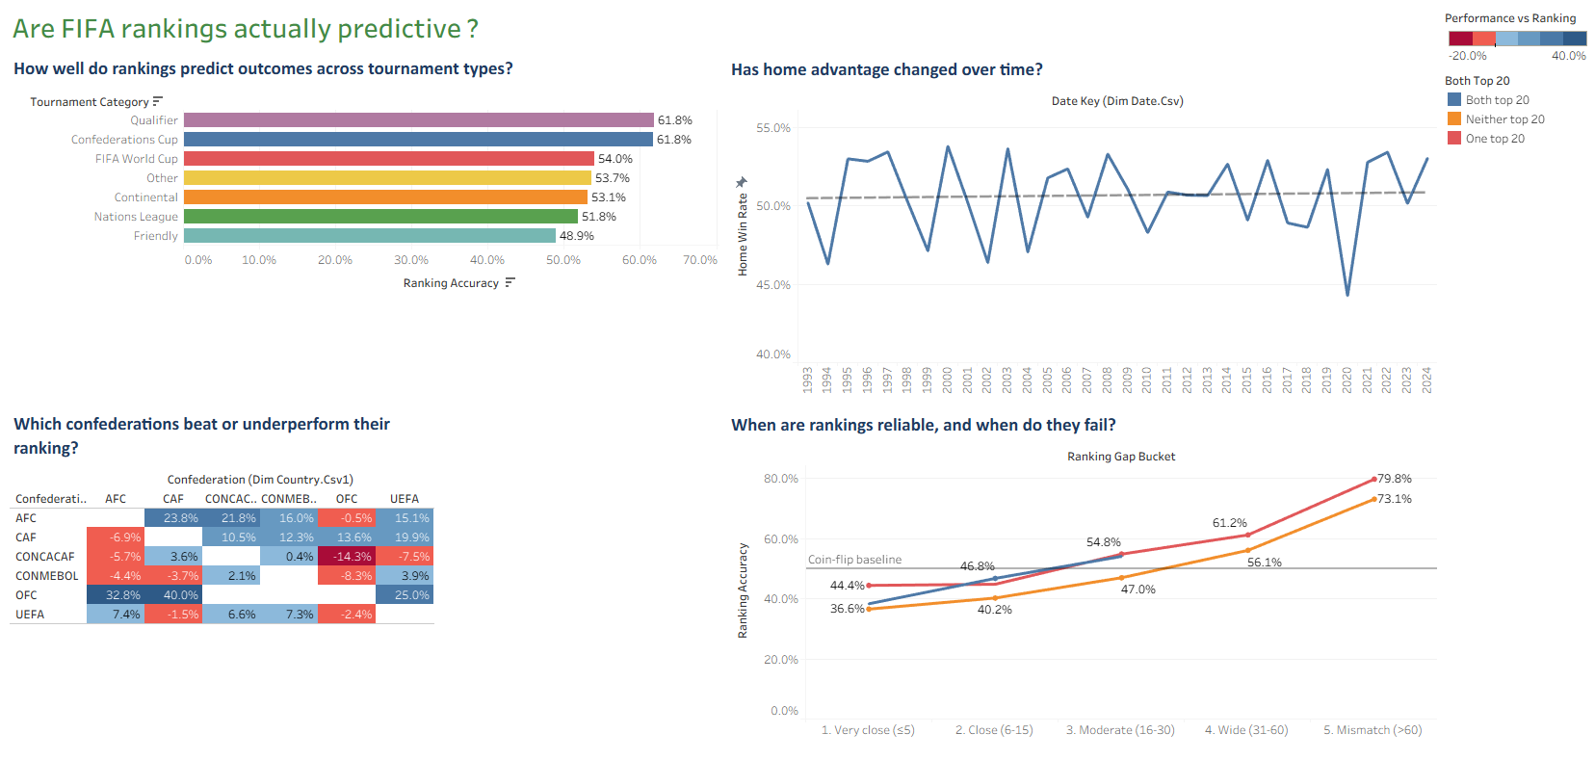
TASK 5 · DASHBOARD
Four charts, one question each
LIVE DEMO
Switching to Tableau
BI Assignment 1 · University of Vienna
8 / 14
Notes:
Switch to Tableau here. Show one live filter — pick FIFA World Cup or a decade — and let the four charts respond. Switch back to slides for findings.

Slide 9
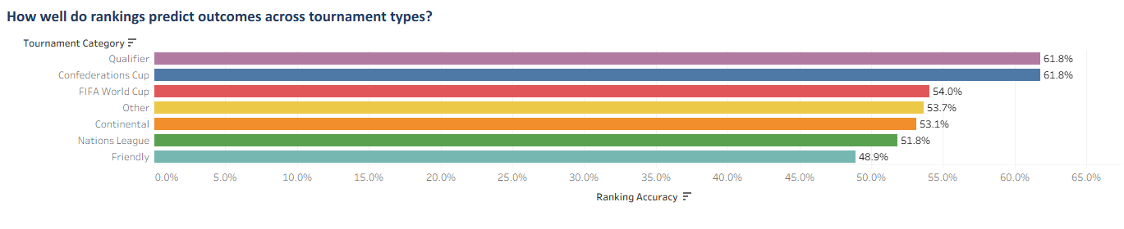
FINDING 1 · Q1
Rankings are a coin flip in friendlies
12.9 pp
WHAT WE FOUND
Rankings pick the winner correctly 62% of the time in qualifiers, but only 49% in friendlies basically a coin flip. World Cup and Continental tournaments sit in the middle at around 54%.
Gap between qualifiers (61.8%) and friendlies (48.9%)
WHY IT MATTERS
Betting models that trust rankings too much lose money on friendlies. Rankings work when teams play hard, not when they rest starters.
BI Assignment 1 · University of Vienna
9 / 14
Notes:
Headline finding. 13pp gap between qualifiers (62%) and friendlies (49%). Friendlies are basically random. Rankings work when stakes force teams to play their best.

Slide 10
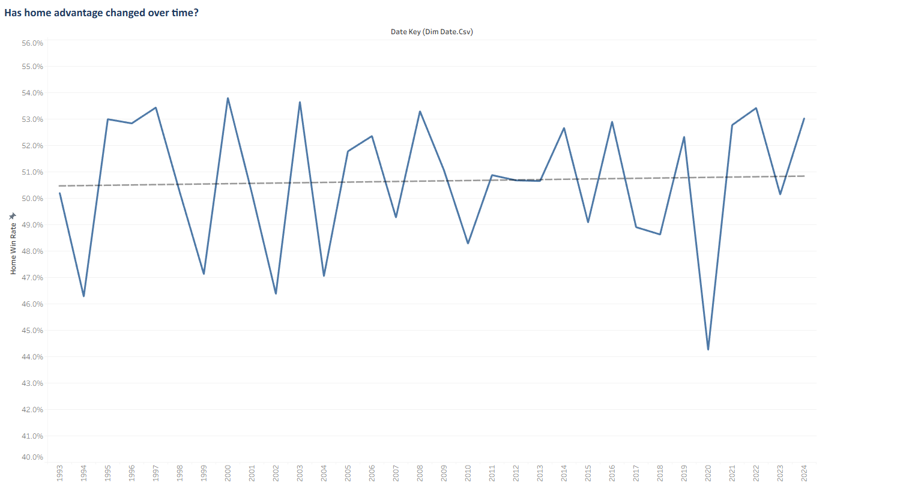
FINDING 2 · Q2
Home advantage hasn't actually declined
p = 0.81
31-year trend is statistically flat (R² = 0.01)
WHAT WE FOUND
Home teams win around 50–51% of the time across all 31 years. The 2020 dip to 44% was the COVID empty stadium effect, but that recovered within two years.
WHY IT MATTERS
The 'home advantage is dying' isn't in the data. This makes it so that hosts don’t need to change fees over an imaginary claim
BI Assignment 1 · University of Vienna
10 / 14
Notes:
Trend slope -0.03 pp/year, p=0.55, R²=0.01. Statistically no decline. Only real movement is the 2020 COVID dip. Narrative doesn't survive the data.

Slide 11
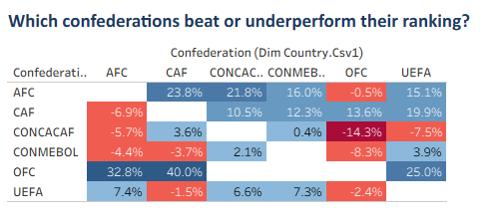
FINDING 3 · Q3
Rankings underrate African and Asian teams across the board
2 of 6
WHAT WE FOUND
The AFC and CAF rows are positive against almost every opponent, both confederations beat their FIFA ranking expectations by 10 to 24pp. UEFA and CONMEBOL are rated within a few points of each other. And the matches between OFC and other confederations are mostly noise, there weren’t a lot of matches played so the results are a bit misleading.
Confederations that consistently beat their ranking
WHY IT MATTERS
Rankings probably overweight regional strength. UEFA teams rack up points against strong neighbors; CAF and AFC teams have fewer strong neighbors. Cross-continental forecasts that ignore confederation will undervalue AFC and CAF teams.
BI Assignment 1 · University of Vienna
11 / 14
Notes:
Most important finding. Filter is neutral venues only — controls for home advantage. CAF beats UEFA 20pp more than predicted. AFC similar. Likely cause: UEFA teams rack up points in a strong regional pool. If asked why neutral: home advantage is a separate effect we measure in Q2; including home matches would mix two signals.

Slide 12
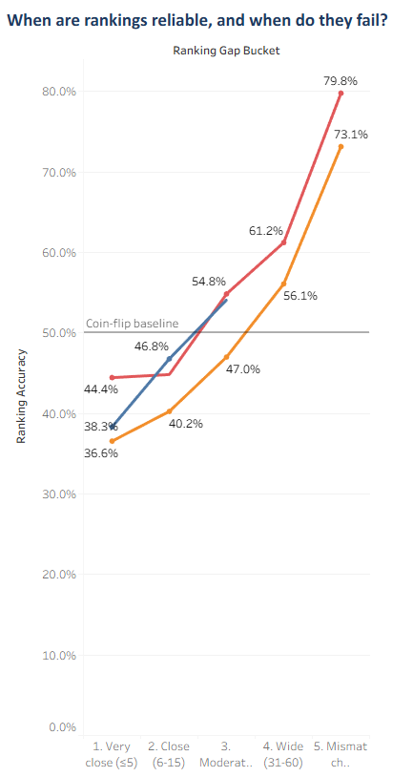
FINDING 4 · Q4
Rankings only predict when the gap is wide
37%
Ranking accuracy for close matchups is below a coin flip
WHAT WE FOUND
For close matchups (gap ≤5), rankings only get it right 37–44%, below 50% because draws cluster here. For big mismatches (gap >60), accuracy jumps to 73–80%. Between two top 20 teams, rankings barely beat chance.
WHY IT MATTERS
Rankings can separate strong teams from weak ones. They can't tell similar teams apart. Tournament seeding between top teams is basically random.
BI Assignment 1 · University of Vienna
12 / 14
Notes:
Below 50% for close matches because draws count as ranking failed. Above 70% for big mismatches. Two top-20 teams: rankings give no edge. Means tournament seeding between elite teams is basically random.

Slide 13
SUMMARY
What rankings actually do and don't do
THEY WORK WHEN
THEY FAIL WHEN
●
The gap is wide (>60): 73 - 80% accuracy
●
It's a friendly (49% - basically random)
●
Matches are important (qualifiers): 62% accuracy, or teams play in major tournaments (World Cup, Continental): 54% accuracy.
●
AFC or CAF play international matches
●
The matchup involves a clearly stronger team: 70%+ accuracy when gap >30
●
Both teams are top 20
Rankings tell strong teams from weak ones.
They can't tell similar teams apart, and they underrate AFC and CAF.
13 / 14
Notes:
Slow down. Read the green box: rankings tell strong from weak, but can't separate similar teams, and they underrate AFC and CAF. That's the headline.

Slide 14
WRAP-UP
Limitations, repo, questions
LIMITATIONS WE KNOW ABOUT
REPOSITORY
Pre 1993 and post 2024 matches dropped
GitHub Repository
Rankings only cover 1992-06 to 2024-06.
Pipeline, raw + clean CSVs, Tableau workbook.
Knockout flag is tournament level
Can't split group vs knockout per match. Basically, removed the group stage/quarter-final etc. and just kept the matches on a tournament level
OFC results are noisy
Questions?
Too few neutral cross confederation matches.
Thank you for listening.
BI Assignment 1 · University of Vienna
14 / 14
Notes:
Three honest limitations. Repo link on slide. Wait for questions, don't fill silence.

